Slide 1


Team 65: Solar Playground with Security System
Bi-Weekly Update 1
Team Members: Zayan Prasla, Alex Allahar, Jackson Kitchel, Victor Igbokwe Sponsor: Wonhyeok Jang TA: Zien Wang
Notes:
Michelle

Slide 2

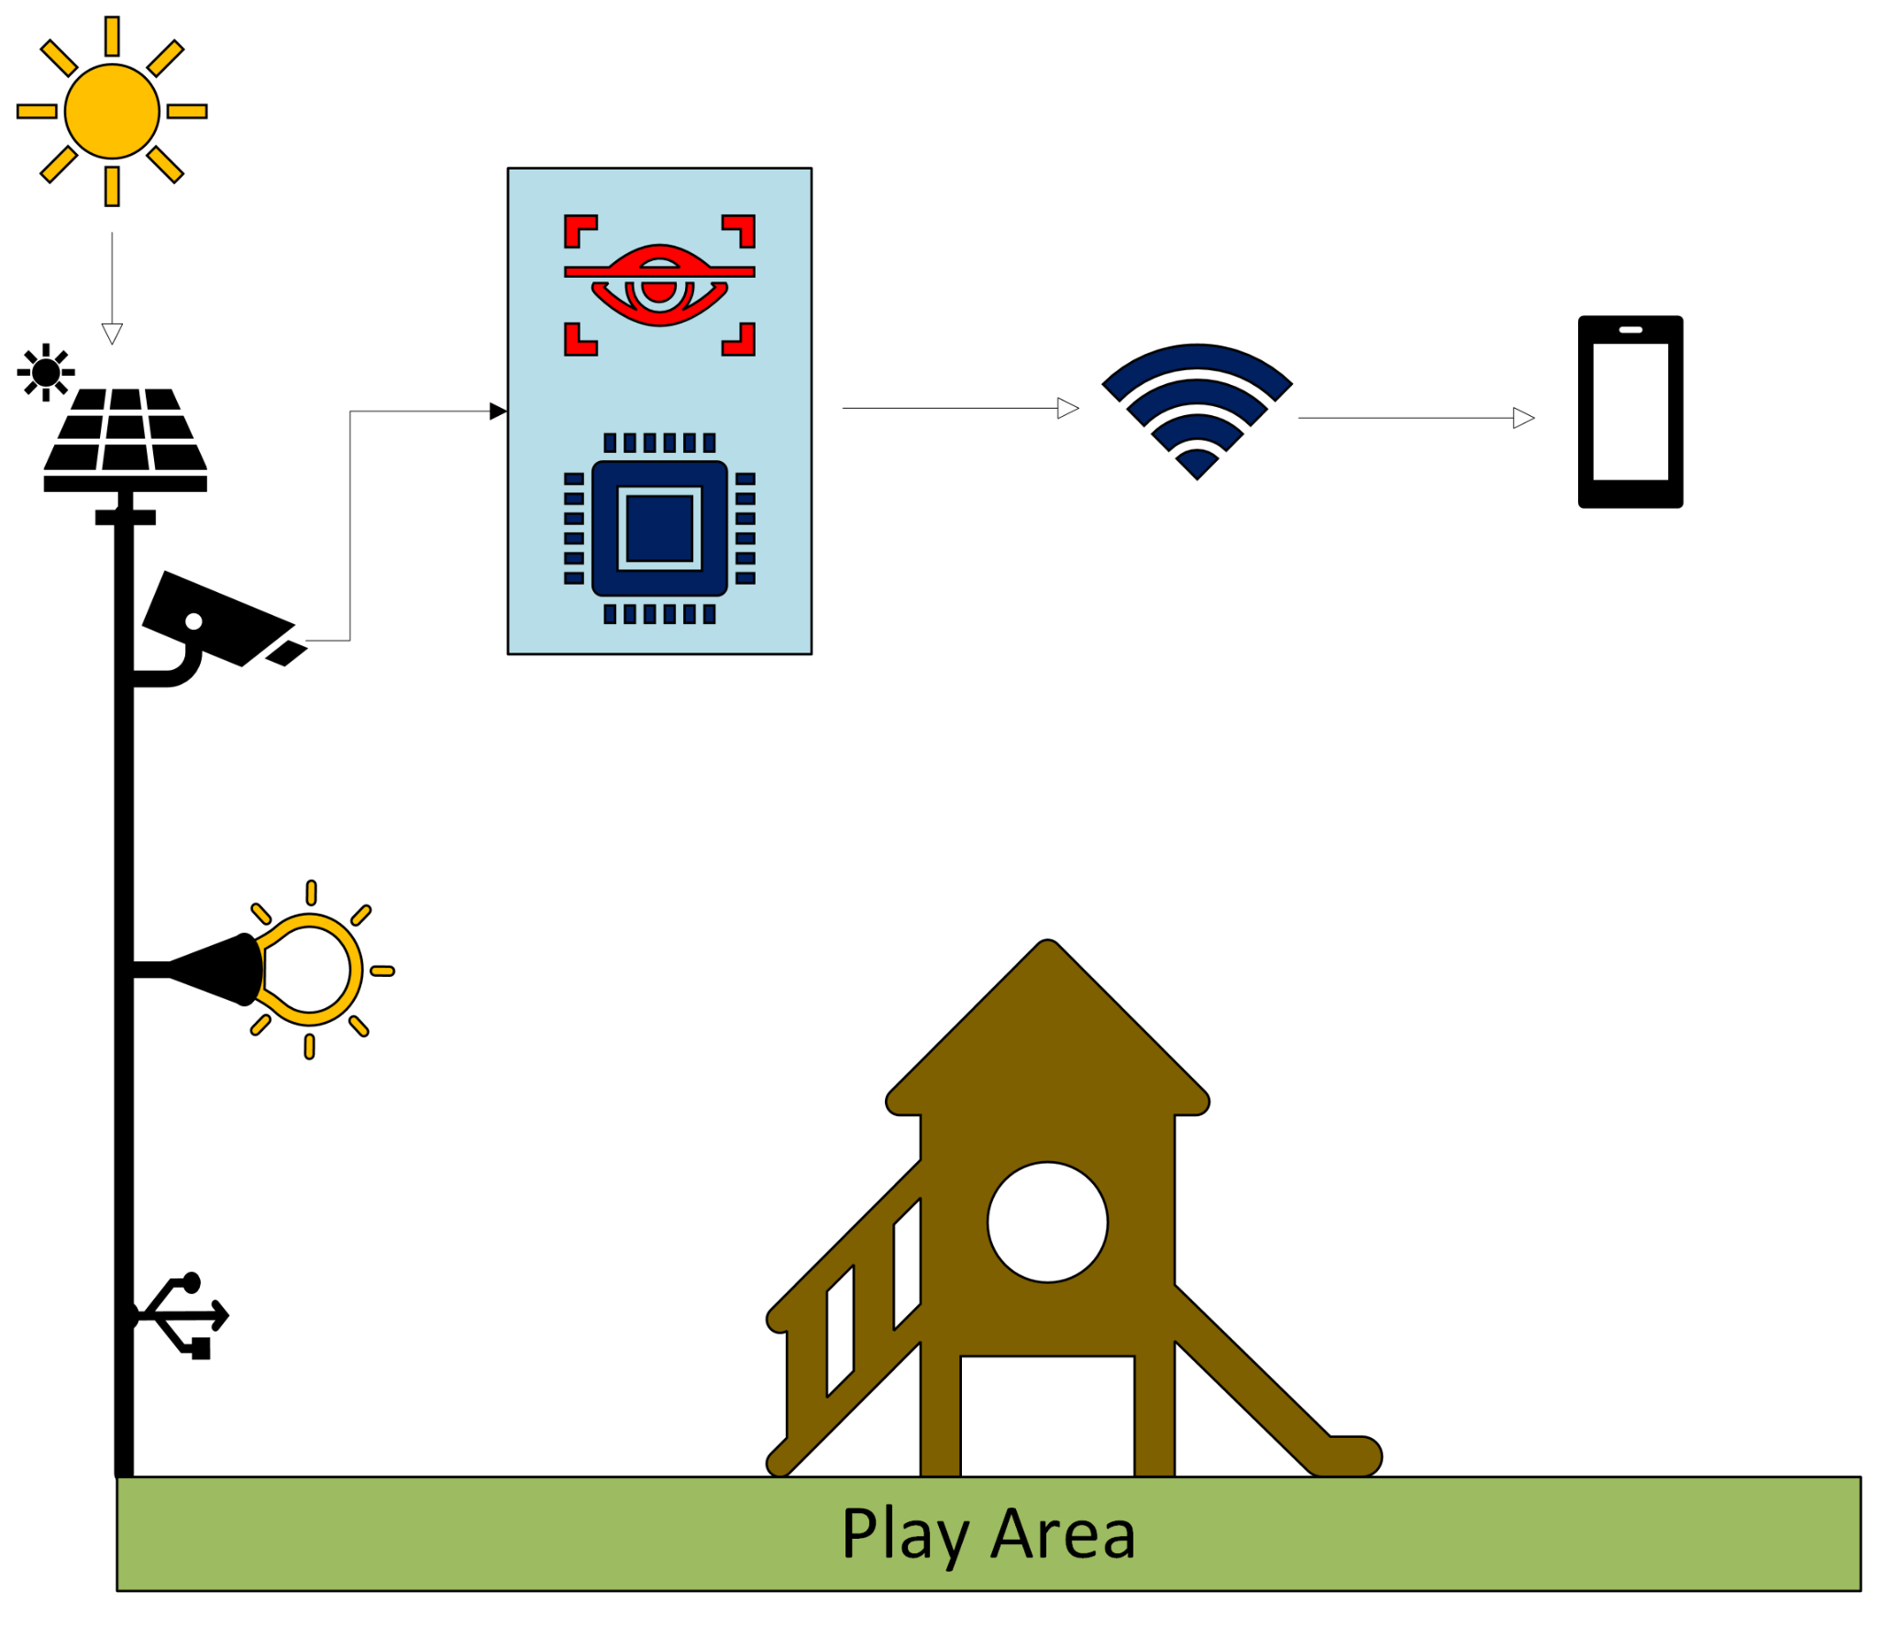
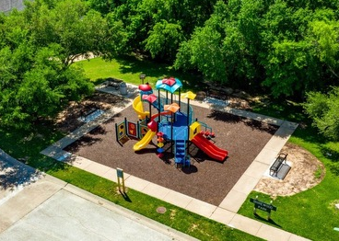
Project Summary
A solar-powered security system with a motion-detecting camera. This system provides near real-time video feeds and send automated alerts for suspicious activity through a mobile app, enhancing safety in these areas.
Notes:
Kyle

Slide 3
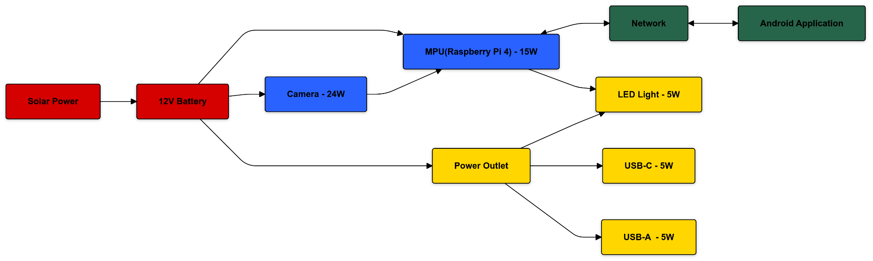
Subsystem Overview
Red - Jackson Kitchel (Power Generation)
Yellow - Victor Igbokwe (Power Distribution)
Blue - Alex Allahar (Microprocessor & Sensors)
Green - Zayan Prasla (Network & Application)
Notes:
Edge processing unit for the system.

Slide 4
Major Project Changes for 404
Removed Object Detection
LED Deterrence
Adding Cooling
Notes:
Bullets on MAJOR changes in project direction due to learning from 403. If stuff didn’t work out now is the time to redirect
-- eg custom to COTS, MCU changes, application change, major change in communication technology, …

Slide 5
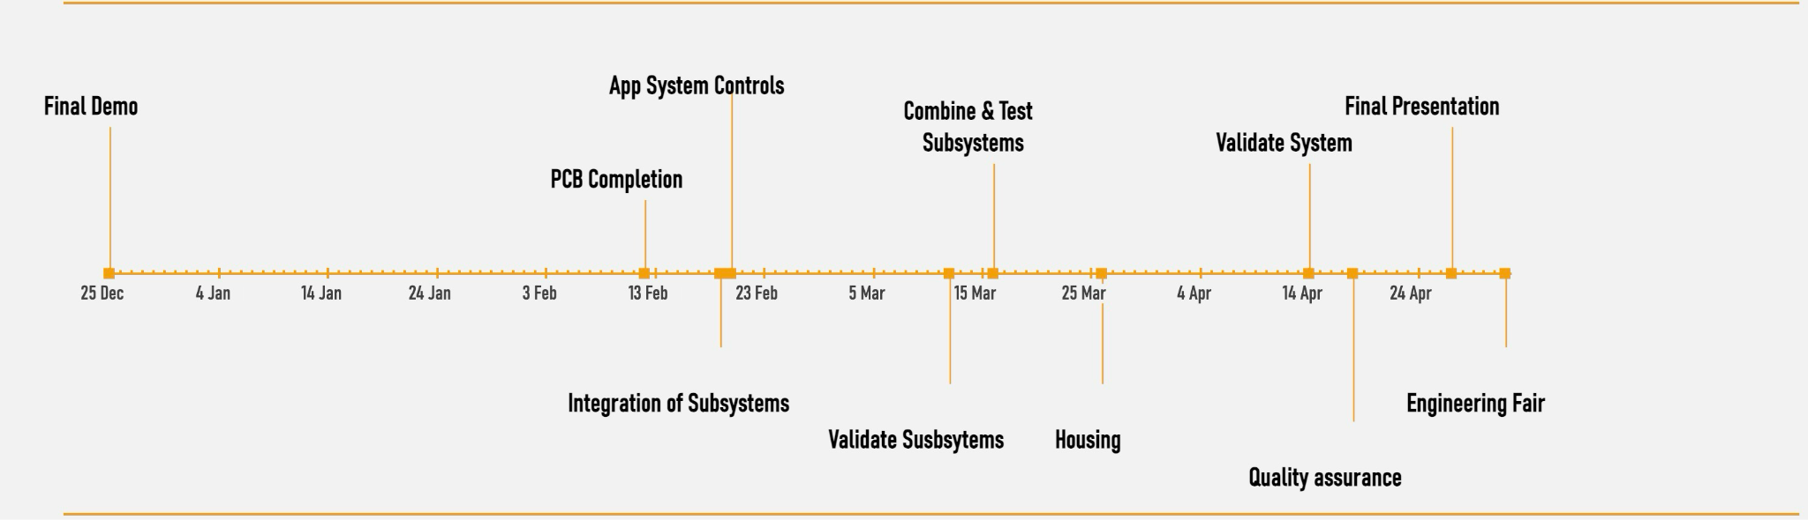
Project Timeline
Notes:
High level figure showing where you are at in the project, what’s completed, what’s underway – it should take about 30 seconds to summarize where you are in the timeline
-- Save discussion for subsystem update
-- Save detail for execution plan & validation plan status

Slide 6
Power Generation
Jackson Kitchel
Accomplishments since 403 | Ongoing progress/problems and plans until the next presentation
PCP has been updated to address issues that were found in 403. Parts and PCB has been ordered. | - Solder and test new PCB upon arrival. - Integrate with other subsystems.

Slide 7
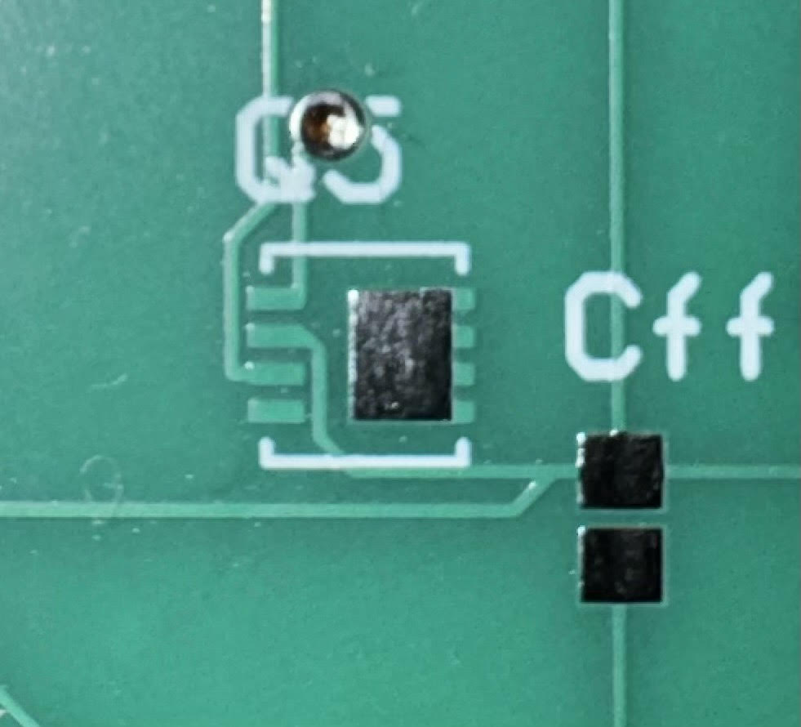
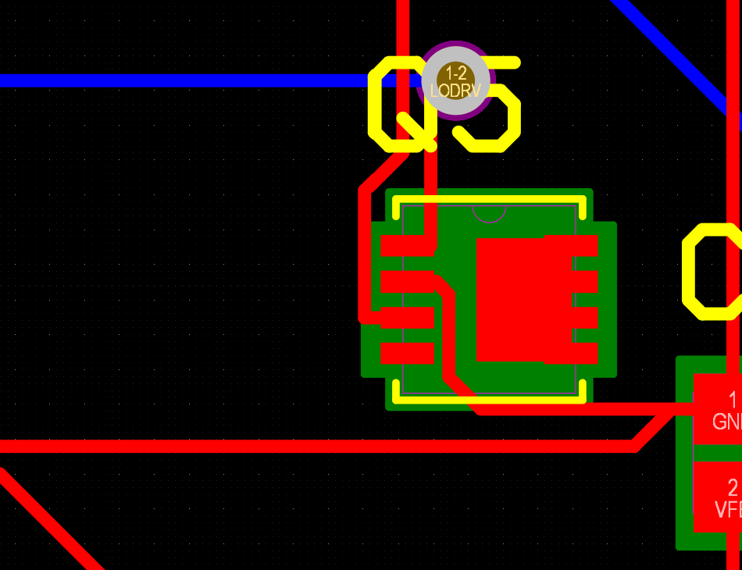
Power Generation
Jackson Kitchel
Problem with footprint and missing
trace to be fixed with new order

Slide 8
Power Distribution
Victor Igbokwe
Accomplishments since 403 | Ongoing progress/problems and plans until the next presentation
Buck Converter system experienced issues due to complexity of IC chip that. New PCB has been designed and ordered using a Texas Instruments IC chip. | Soldering and testing my new buck converter system. Design and order a new PCB that will implement using an N-Channel Mosfet as a switch to control the Security light.
-

Slide 9
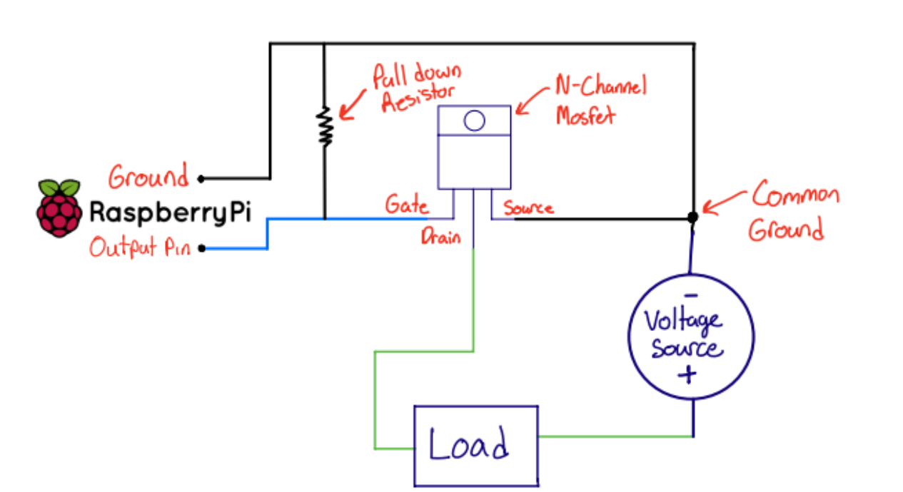
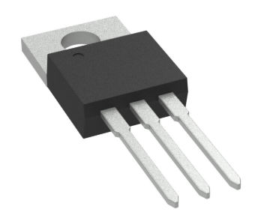
Power Distribution
Victor Igbokwe
Still Developing:
Using N-channel as a switch
Common Ground between microcontroller and Power supply
Pull-down resistor at the output pin.
Setting the output pin to High will allow current flow while setting it to low will disrupt current flow.

Slide 10
Microprocessor & Sensors
Alex Allahar
Accomplishments since 403 | Ongoing progress/problems and plans until the next presentation
Tested and Validation CSI Camera | Integration of Firebases Designing the cooling and housing for MPU, Camera, & Sensors.

Slide 11
Microprocessor & Sensors
Low-Power Mode
Works
GPIO Sensors
Automated Video Capture
Fixed / Variable
Thumbnails Generation
Local Event History
Cloud Video Storage
Streaming Mode
Works
Real-Time LIve Stream
Live Stream Web Server
OpenCV Motion Detection
App Notification
Still Developing
User Activation via App

Slide 12
Subsystem 4 Application
Zayan Prasla
Accomplishments since 403 | Ongoing progress/problems and plans until the next presentation
Removed fixed event history examples from 403 and connected it to Firebase for live updates. Added reset password for the login page and connected it via backend to the user’s specific email. | App to microprocessor connection via Firebase Camera and LED controls Live stream Constantly improving frontend UI as well

Slide 13
Subsystem 4 Application
Zayan Prasla
Backend/Security
Works
User Login and Account Creation
Password Policy Enforced
User accounts stays logged in until manually logged out
Email Verification
Verification link expires after 5 minutes
Internet Connection
Password Reset
Email Address Change
Event History connected to Firebase Realtime Database
Still Developing
App to Microprocessor connection
New Sign-in Methods
SMS Verification
2-step verification
Frontend
Works
Login, Create Account, Home, Settings, and Event History pages all work
SOS button
Error messages for when password policy is not properly followed or
User friendly UI
Still Developing
Improvements to the home page UI is needed
Camera and LED buttons are visible but not yet functional
Charging Statistics

Slide 14
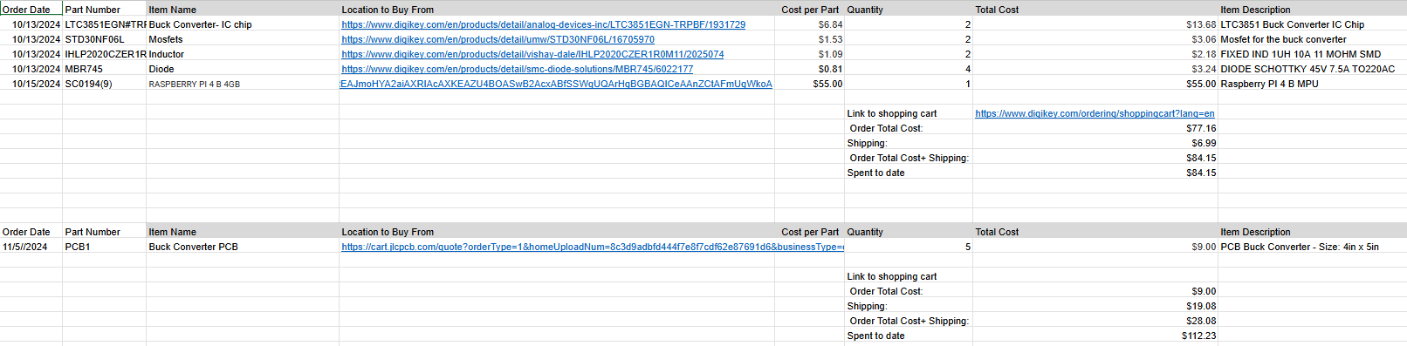
Parts Ordering Status
Notes:
Most parts orders for 404 should be placed very soon.
Provide summary of what is ordered but not received and what remains to be ordered.
When do you expect to have all parts?

Slide 15
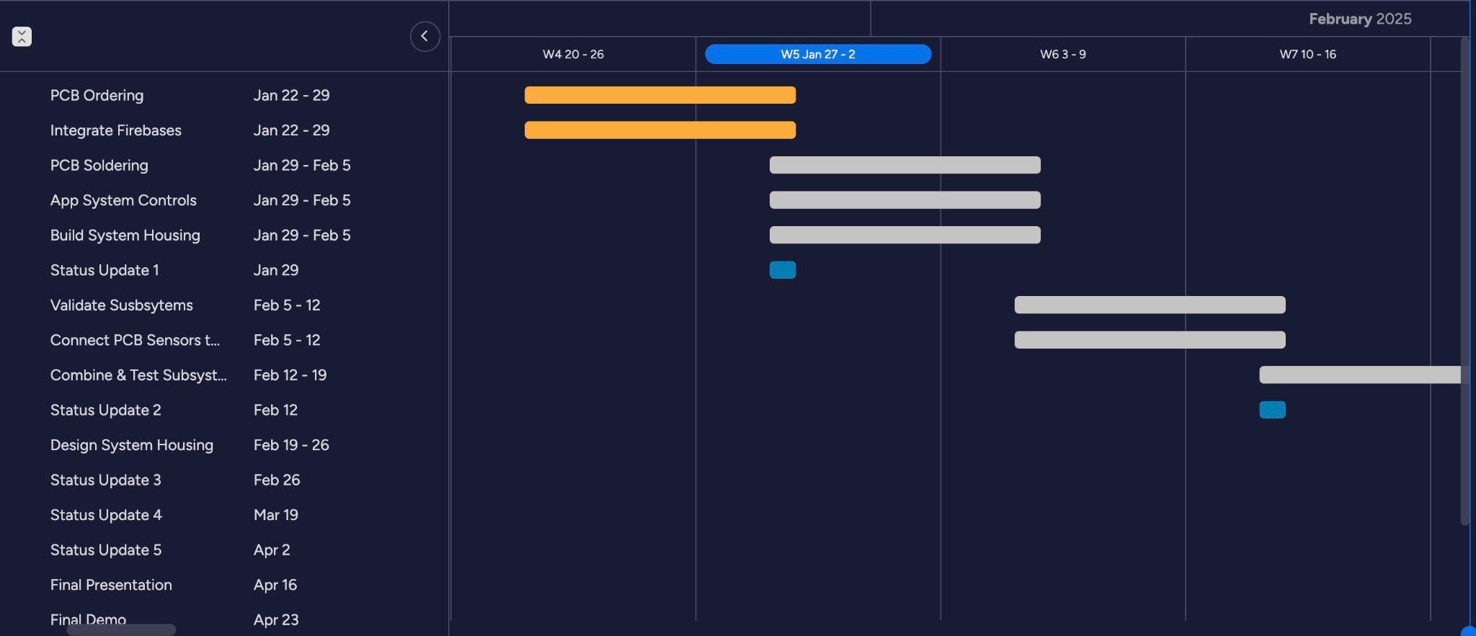
Execution & Plan
Notes:
Execution plan
Your team planned milestones for completion of any remaining subsystem functionality, integration of specific subsystems, test, and validation plans should be presented.
Milestones should have owners … things like final integration can be group owned
Gantt chart – should indicate some 404 progress.
Try to complete all subsystem function in next 3 weeks.
Try to complete all integration 2 weeks before demo to allow for system validation and documentation

Slide 16
Thank You

